Slide 1
GCBASIC
PIC18FxxQ35
Part 20 - Summary

Slide 2
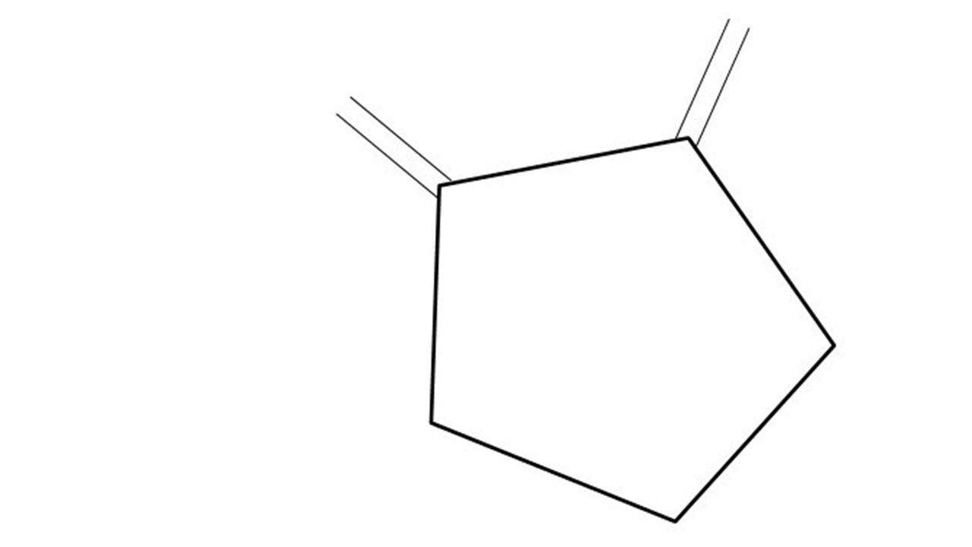
GCBASIC
PIC18FxxQ35
Part 20 - Summary

Slide 3
GCBASIC
Like and subscribe!

Slide 4
PIC18FxxQ35
18FxxQ35 is a high performance PIC16
  8Digital and analog peripherals for flexible embedded control
  10-bit ADC for accurate analog signal conversion
  Multiple communication interfaces including UART (serial), I²C, and SPI
  PWM modules with CCP and 16-bit resolution for precise timing and motor control
  Configurable Logic Cells (CLCs) for custom hardware-level logic without external components
  Integrated op amps for onboard analog signal conditioning and amplification
  And, more…
The 18FxxQ35 offers 14, 20, 28, 40 and 44-pin products in small footprint packages to support customers in a wide variety of applications.

Slide 5
Videos...
Install the hardware and make the board work – three LED programs
Make four LEDs flash in a sequence
Set the LEDs to represent the value of ADC
Sequence the LEDs with a delay using the value of ADC
Using an input to set the state of the LEDs
Using the reset switch
Using the switch, ADC – make the LEDs flash in a sequence with reverse
Using the serial to display values
Using the timer0 overflow, 8bit timer, 16bit timer to flash the LEDs
Using EEProm – showing values on the serial terminal, and more constants insights
Using I2C with serial to discover I2C devices
Using I2C GCLD display solutions
Using a SPI GLCD display solutions
Using PWM, 6 ways, to dim the LEDS
Using an external interrupt to control an LED
Using storage within the chip
Using CLC
The GCBASIC tool chain
Assembly , alternatives assemblers and Debugging
Summary

Slide 6
GCBASIC Compiler
GCBASIC Compiler
GCBASIC is an Open Source compiler for PIC, AVR and LGT microcontrollers
GCBASIC now supports the 18FxxQ35 chip family
GCBASIC is a cross platform with common code translation

Slide 7
The core compiler
High Level Language
Reports:
TXT and HTML
Source Code
GCBASIC Compiler
GCBASIC Compiler
Preprocessor
Code Translator
Assembler
Linker
Assembly Language
ASM file
Absolute Machine Code
HEX file
Libraries
8 bit PIC, AVR, AVR-DX and LGT

Slide 8
Compiler options
High Level Language
Reports:
TXT and HTML
Source Code
PIC-AS, MPASM,
MPLAB-IDE,
GPASM, AVRASM2
GCBASIC Compiler
GCBASIC Compiler
Preprocessor
Code Translator
Assembler
Linker
Assembly Language
file
Absolute Machine Code
HEX file
Libraries
8 bit PIC, AVR, AVR-DX and LGT

Slide 9
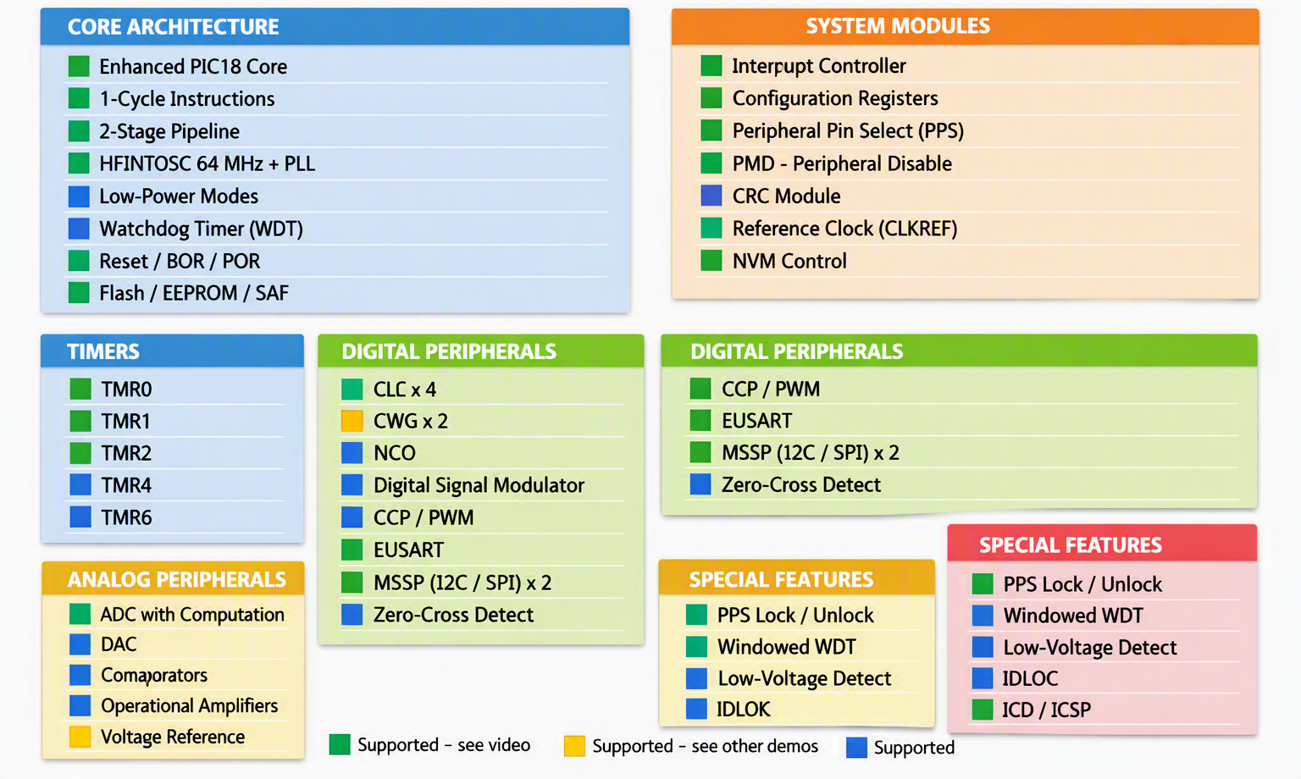
Capability Review

Slide 10
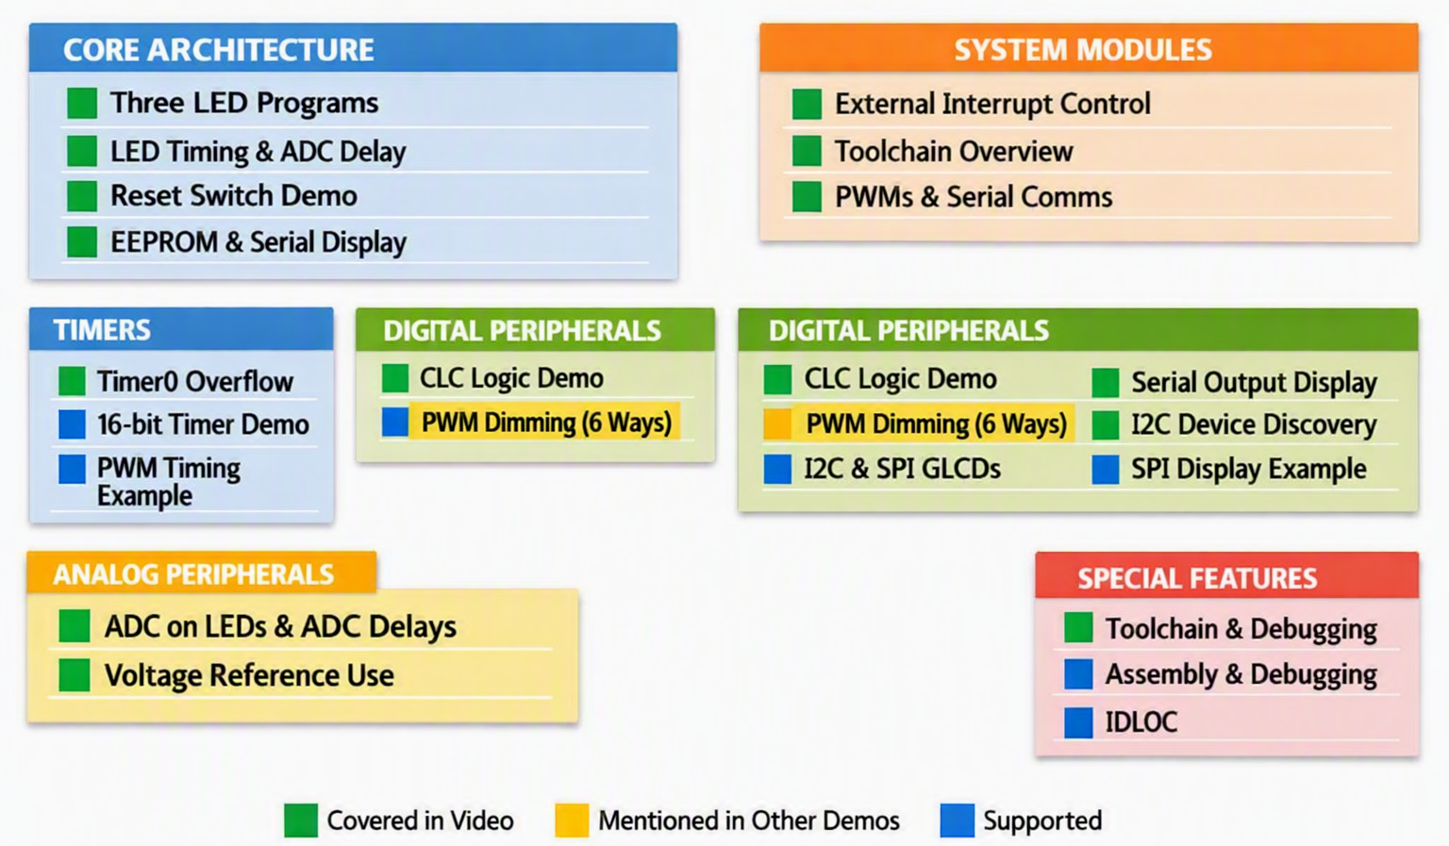
Tutorial Review

Slide 11
Resources
Tutorial source code
  https://github.com/GreatCowBASIC/Demonstration_Sources/tree/main/Vendor_Boards/Microchip_PICDEM%202%20plus_board_2010/18f
  Tutorial presentations
  https://github.com/GreatCowBASIC/Demonstration_Sources/tree/main/Vendor_Boards/Microchip_PICDEM%202%20plus_board_2010/18f/tutorials

Slide 12
GCBASIC
PIC18FxxQ35
The end

